Slide 1
CS2422 Assembly Language & System Programming
November 25, 2003

Slide 2
Today’s Topic
Assembler: Basic Functions

Slide 3
Study Guide
Section 2.1 of Beck’s “System Software” book.
Reading Assignment: pages 43-52.

Slide 4
Role of Assembler
Assembler
Object
Code
Linker
Source
Program
Executable
Code
Loader

Slide 5
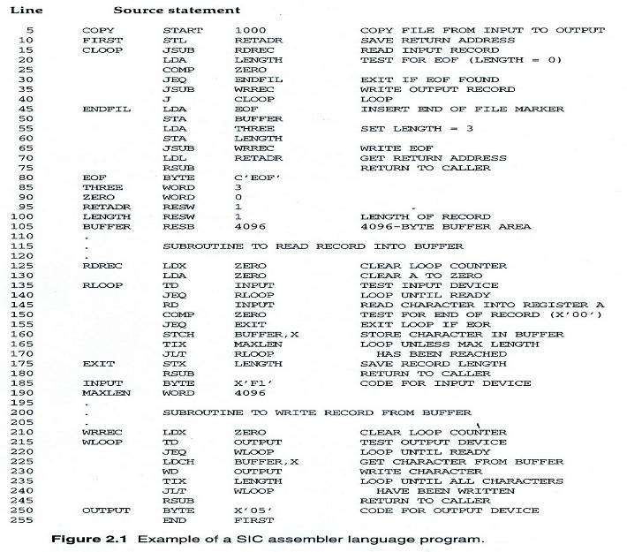
Example Program Fig. 2.1 (1/3)

Slide 6
Example Program Fig. 2.1 (2/3)
Purpose
  Reads records from input device (code F1)
  Copies them to output device (code 05)
  At the end of the file, writes EOF on the output device, then RSUB to the operating system

Slide 7
Example Program Fig. 2.1 (3/3)
Data transfer (RD, WD)
  A buffer is used to store record
  Buffering is necessary for different I/O rates
  The end of each record is marked with a null character (00₁₆)
  The end of the file is indicated by a zero-length record
Subroutines (JSUB, RSUB)
  RDREC, WRREC
  Save link register first before nested jump

Slide 8
Assembler Directives
Pseudo-Instructions
  Not translated into machine instructions
  Providing information to the assembler
Basic assembler directives
  START
  END
  BYTE
  WORD
  RESB
  RESW

Slide 9
Functions of a Basic Assembler
Mnemonic code (or instruction name) → opcode.
Symbolic operands (e.g., variable names) → addresses.
Choose the proper instruction format and addressing mode.
Constants → Numbers.
Output to object files and listing files.

Slide 10
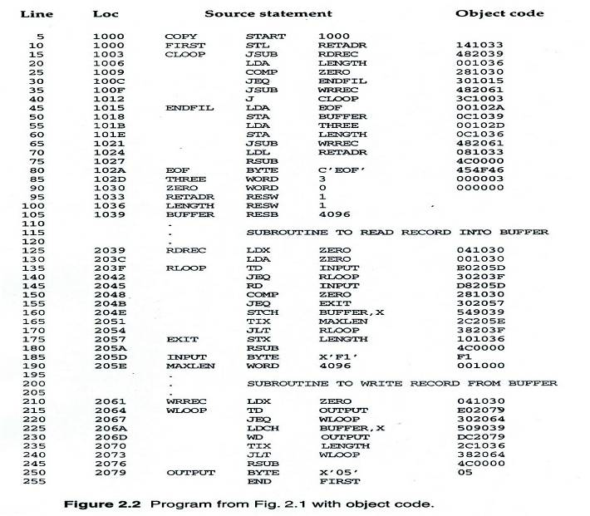
Example Program with Object Code

Slide 11
SIC Instruction Set (Review)
Load/Store: LDA/STA, LDX/STX…etc.
Arithmetic: ADD, SUB, MUL, DIV
Compare: COMP
Jump: J
Conditional Jump: JLT, JEQ, JGT
See Appendix A for the complete list.

Slide 12
SIC Instruction Format (again)
Opcode: 8 bits
Address: one bit flag (x) and 15 bits of address
8
1
15
OPCODE
X
Address

Slide 13
Examples
Mnemonic code (or instruction name) → opcode.
Examples:
  STL 1033 → opcode 14 10 33
  LDA 1036 → opcode 00 10 36
0001 0100
0
001 0000 0011 0011
0000 0000
0
001 0000 0011 0110

Slide 14
Symbolic Operands
We’re not likely to write memory addresses directly in our code.
  Instead, we will define variable names.
Other examples of symbolic operands:
  Labels (for jump instructions)
  Subroutines
  Constants

Slide 15
Converting Symbols to Numbers
Isn’t it straightforward?
  Isn’t it simply the sequential processing of the source program, one line at a time?
  Not so, if we have forward references.
COPY START 1000
  …
LDA LEN
…
…
LEN RESW 1

Slide 16
Two Pass Assembler
Pass 1
  Assign addresses to all statements in the program
  Save the values assigned to all labels for use in Pass 2
  Perform some processing of assembler directives
Pass 2
  Assemble instructions
  Generate data values defined by BYTE, WORD
  Perform processing of assembler directives not done in Pass 1
  Write the object program and the assembly listing

Slide 17
Two Pass Assembler
Read from input line
  LABEL, OPCODE, OPERAND
Source
program
Intermediate
file
Object
codes
Pass 1
Pass 2
OPTAB
SYMTAB
SYMTAB

Slide 18
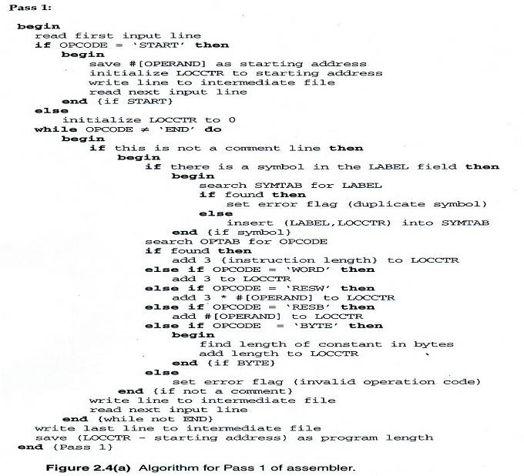
Two Pass Assembler – Pass 1

Slide 19
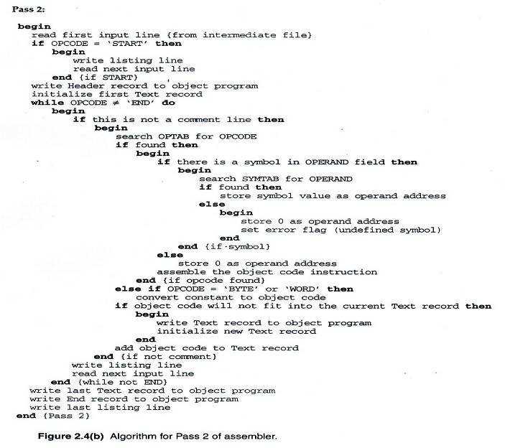
Two Pass Assembler – Pass 2

Slide 20
Data Structures
Operation Code Table (OPTAB)
Symbol Table (SYMTAB)
Location Counter(LOCCTR)

Slide 21
OPTAB (operation code table)
Content
  Menmonic, machine code (instruction format, length) etc.
Characteristic
  Static table
Implementation
  Array or hash table, easy for search

Slide 22
SYMTAB (symbol table)
Content
  Label name, value, flag, (type, length) etc.
Characteristic
  Dynamic table (insert, delete, search)
Implementation
  Hash table, non-random keys, hashing function
COPY 1000
FIRST 1000
CLOOP 1003
ENDFIL 1015
EOF 1024
THREE 102D
ZERO 1030
RETADR 1033
LENGTH 1036
BUFFER 1039
RDREC 2039

Slide 23
One-Pass Assemblers
Forward references can be resolved in One-Pass Assemblers too!
Add a linked list to the Symbol Table to keep track of unresolved references.

Slide 24
Object Program
Header
  Col. 1 H
  Col. 2~7 Program name
  Col. 8~13 Starting address (hex)
  Col. 14-19 Length of object program in bytes (hex)
Text
  Col.1 T
  Col.2~7 Starting address in this record (hex)
  Col. 8~9 Length of object code in this record in bytes (hex)
  Col. 10~69 Object code (69-10+1)/6=10 instructions
End
  Col.1 E
  Col.2~7 Address of first executable instruction (hex)
  (END program_name)

Slide 25
Fig. 2.3
H COPY 001000 00107A
T 001000 1E 141033 482039 001036 281030 301015 482061 ...
T 00101E 15 0C1036 482061 081044 4C0000 454F46 000003 000000
T 002039 1E 041030 001030 E0205D 30203F D8205D 281030 …
T 002057 1C 101036 4C0000 F1 001000 041030 E02079 302064 …
T 002073 07 382064 4C0000 05
E 001000 ←starting address

